Slide 1
Scout2 Overview
Scout2 is a security tool that lets AWS administrators assess their environment's security posture. Using the AWS API, Scout2 gathers configuration data for manual inspection and highlights high-risk areas automatically. Rather than pouring through dozens of pages on the web, Scout2 supplies a clear view of the attack surface automatically.

Slide 2





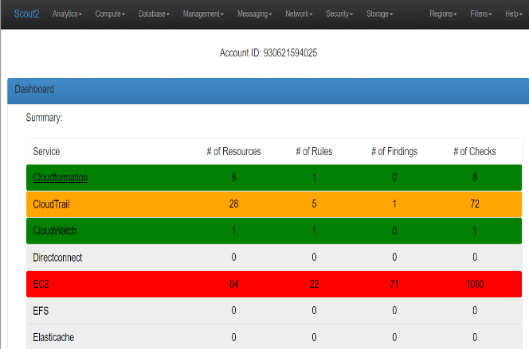
Scout2 Architecture
Amazon EC2
Cross account role for Account1
Administrator
Scout2
Cross account role
security group 80 443
Cross account role for Account N
Cross account role for Account 2
Users

Slide 3
Prerequisites
T2.Medium Ec2 instance
Ports 80, 443
Role (Security Audit, SNS Read Only, Elastic File System Read Only Access)
Access to Amazon endpoint via internet
Python(2.7, 3.3, 3.4, 3.5,3.6)
PIP
Boto3
Cross account role if you have multiple accounts

Slide 4
Installation
Install from source
$ git clone https://github.com/nccgroup/Scout2
$ cd Scout2
$ pip install –r requirements.txt
$ python setup.py install

Slide 5
Cross Account role implementation-1
Cross Account Policy in Account A for Account C & D
{
"Version": "2012-10-17",
"Statement": [
{
"Effect": "Allow",
"Action": "sts:AssumeRole",
"Resource": "arn:aws:iam::12345678910:role/cross-account-C"
},
{
"Effect": "Allow",
"Action": "sts:AssumeRole",
"Resource": "arn:aws:iam::12345678910:role/cross-account-D"
}
]
}

Slide 6
Cross Account role implementation-2
Cross Account Trust relationship in Account B, Account N
{
"Version": "2012-10-17",
"Statement": [
{
"Effect": "Allow",
"Principal": {
"AWS": "arn:aws:iam::12345678910:root" # Account A ARN
},
"Action": "sts:AssumeRole",
"Condition": {}
}
]
}

Slide 7
Scout2 Usage
Usage
After performing a number of AWS API calls, Scout2 will create a local HTML report and open it in the default browser.
Using a computer already configured to use the AWS CLI, boto3, or another AWS SDK, you may use Scout2 using the following command:
$ Scout2
Note: EC2 instances with an IAM role fit in this category.
If multiple profiles are configured in your .aws/credentials and .aws/config files, you may specify which credentials to use with the following command:
$ Scout2 --profile <PROFILE_NAME>
If you have a CSV file containing the API access key ID and secret, you may run Scout2 with the following command:
$ Scout2 --csv-credentials <CREDENTIALS.CSV>

Slide 8
Additional Resources -1
AWS Credentials
To run Scout2, you will need valid AWS credentials (e.g Access Key ID and Secret Access Key). The role, or user account, associated with these credentials requires read-only access for all resources in a number of services, including but not limited to CloudTrail, EC2, IAM, RDS, Redshift, and S3.
If you are not sure what permissions to grant, the Scout2-Default IAM policy lists the permissions necessary for a default run of Scout2.
Compliance with AWS' Acceptable Use Policy
Use of Scout2 does not require AWS users to complete and submit the AWS Vulnerability / Penetration Testing Request Form. Scout2 only performs AWS API calls to fetch configuration data and identify security gaps, which is not considered security scanning as it does not impact AWS' network and applications.

Slide 9
Additional Resources -2
Advanced documentation
The following command will provide the list of available command line options:
$ Scout2 --help
For further details, checkout our GitHub pages at
https://nccgroup.github.io/Scout2.
License
GPLv2: See LICENSE.

